Slide 1
OPERATING SYSTEM
(PROCESS MANAGEMENT)
By Amar Panchal
Prof.Amar Panchal

Slide 2
Process----------------------Program
The Process
A process is a program in execution.
Prof.Amar Panchal

Slide 3
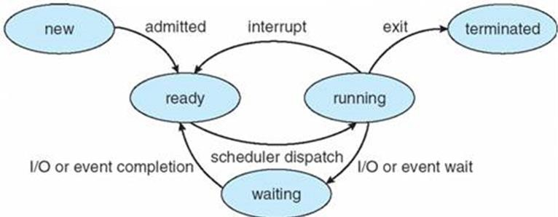
Process State
Prof.Amar Panchal

Slide 4
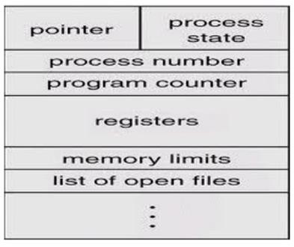
Process Control Block
Prof.Amar Panchal

Slide 5
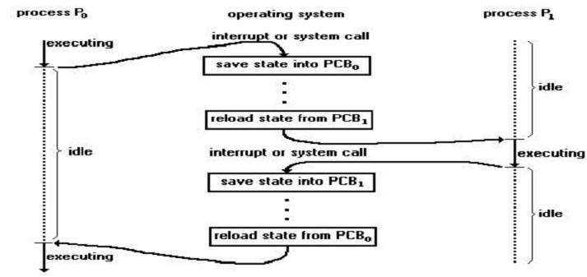
Context Switching
Prof.Amar Panchal

Slide 6
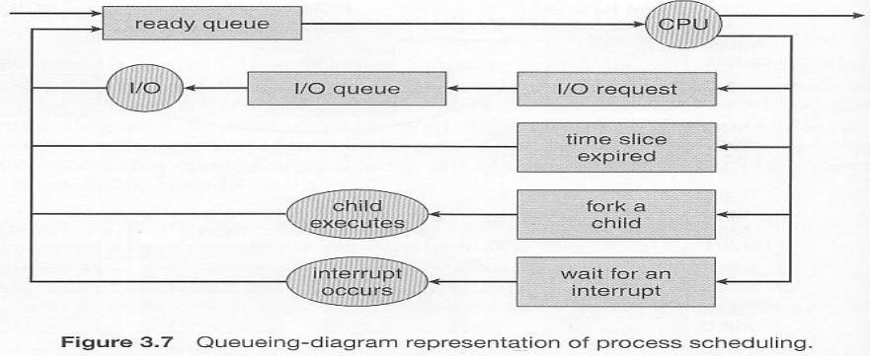
Scheduling Queues
Prof.Amar Panchal

Slide 7
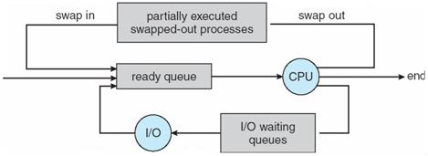
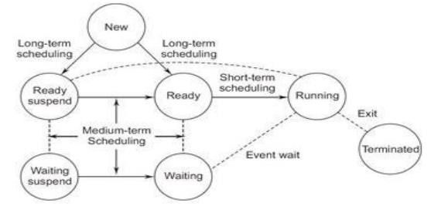
Schedulers
Prof.Amar Panchal

Slide 8
PROCESS SCHEDULING
Scheduling criteria
a) CPU utilization: Keep the CPU as busy as possible
b) Through put: One measure of work of CPU is the number of
processes that are completed per time unit called through put.
c) Turnaround time: The interval from the time of submission of a process to the time of completion is the turnaround time. Turnaround time is the sum of the periods spent waiting to get into memory, waiting in the ready queue, executing on the CPU and doing I/O.
d) Waiting time: It is the sum of the periods spent waiting in
the ready queue.
e) Response time: The time it takes for the process to start
responding but is not the time it takes to output the response.
Prof.Amar Panchal

Slide 9
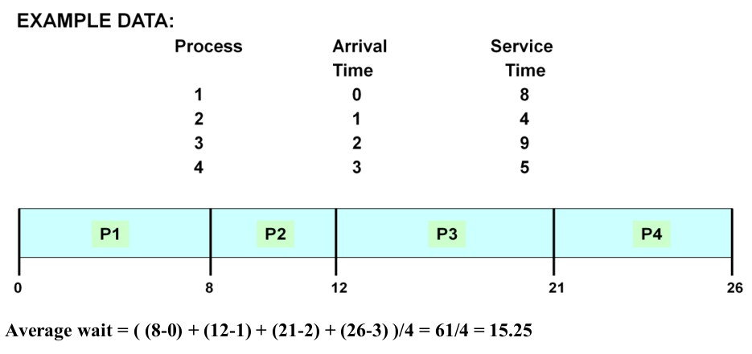
Scheduling algorithms
First Come First Serve:
Prof.Amar Panchal

Slide 10
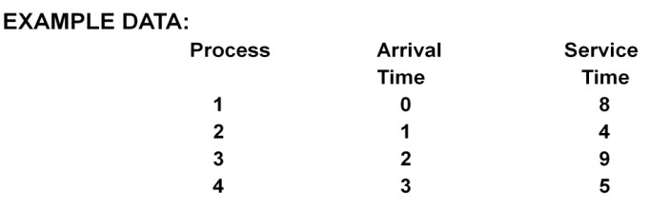
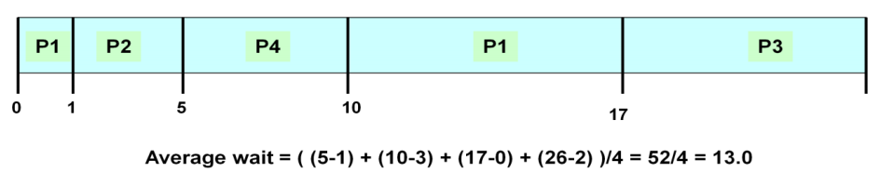
Shortest Job First:
Prof.Amar Panchal

Slide 11
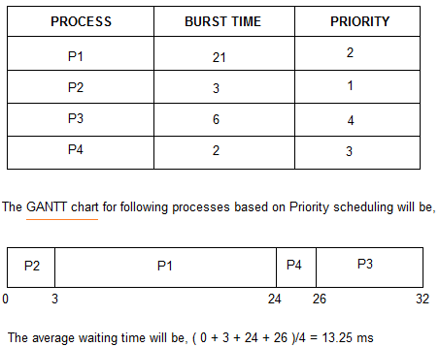
Priority
Prof.Amar Panchal

Slide 12
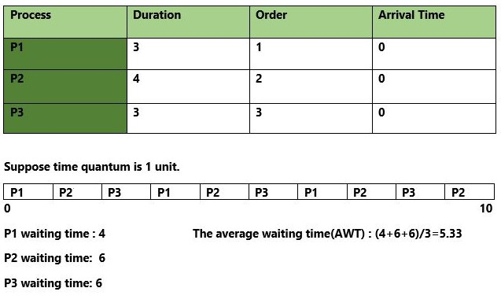
Round Robin
Prof.Amar Panchal

Slide 13
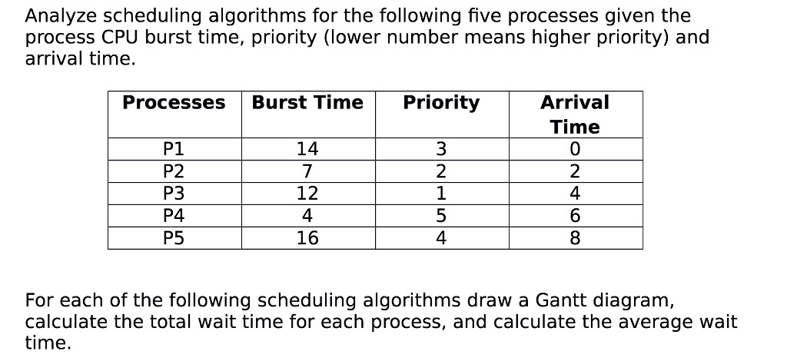
Problem
Prof.Amar Panchal

Slide 14
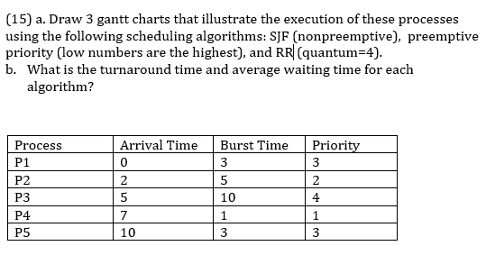
Problem
Prof.Amar Panchal

Slide 15
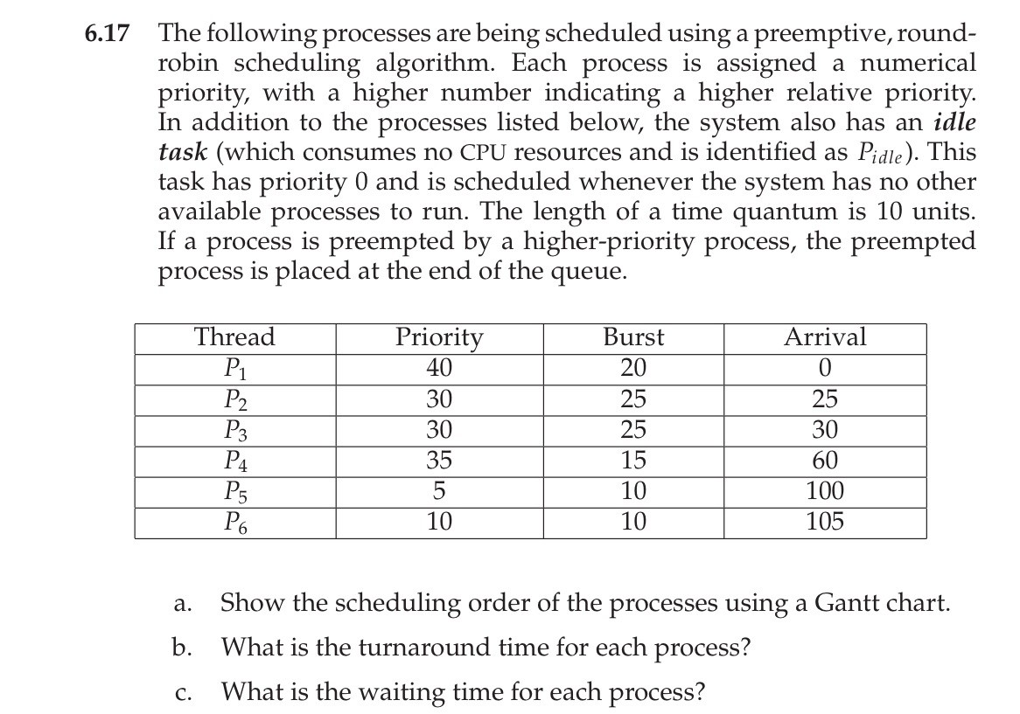
Problem
Prof.Amar Panchal

Slide 16
PROCESS -SYNCHRONIZATION
Need
a) Information sharing – Since several users may be interested in the same piece of information, we must provide an environment to allow concurrent access to such information.
b) Computation speedup – If we want a particular task to run faster, we must break it into sub tasks each of which will be executing in parallel with the others. Such a speed up can be achieved only if the computer has multiple processing elements.
c) Modularity – Construct the system in a modular fashion dividing the system functions into separate processes or threads.
d) Convenience – Even an individual user may work on many
tasks at the same time.
Prof.Amar Panchal

Slide 17
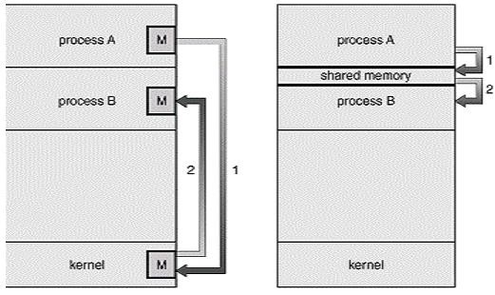
Communication Basics (cooperative)
1. Shared memory 2. Message Passing
Prof.Amar Panchal

Slide 18
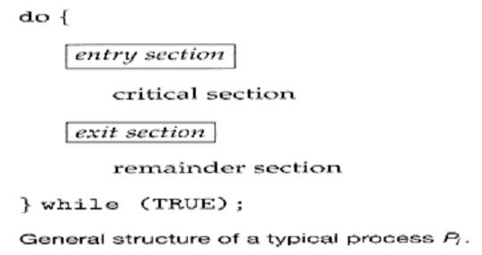
The Critical Section Problem
Prof.Amar Panchal

Slide 19

Prof.Amar Panchal

Slide 20
Solution to critical section should have
Mutual exclusion: If a process is executing in critical section,
then no other process can be executing in their critical section.
Progress: If no process is executing in its critical section and some processes wish to enter their critical sections, then only those processes that are not executing in their remainder sections can participate in the decision on which will enter its critical section next and this selection cannot be postponed indefinitely.
Bounded waiting: There exists a bound or limit on the number of times that other processes are allowed to enter their critical section after a process has made a request to enter its critical section and before that request is granted.
Prof.Amar Panchal

Slide 21
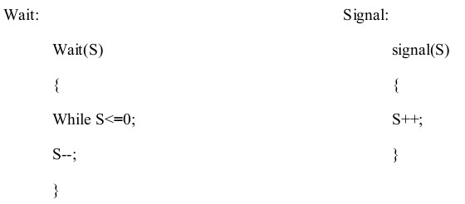
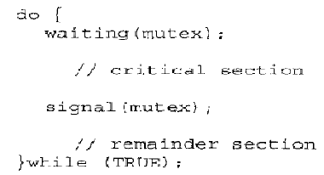
Semaphores
Prof.Amar Panchal

Slide 22
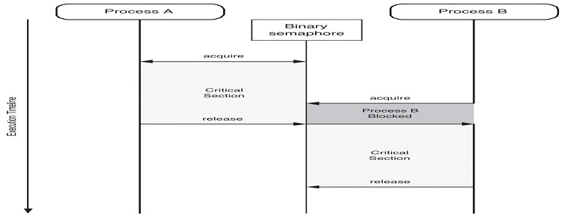
Prof.Amar Panchal

